Slide 1

CYMATICS
Innovation Project
CYMATICS
CYMATICS

Slide 2
ROBOT DESIGN

Slide 3






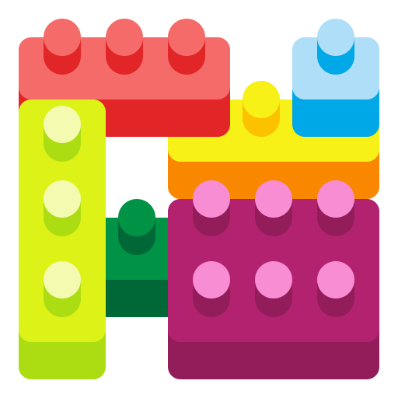
Engineering Robot Design
Hi there.. we are team “V2V”, For our robot design, we tried to improve on the mistakes we made last year. Our primary goal for this year is to have a very effective way to add and remove attachments quickly.
1. Identify the mission to work on and the challenges involved in implementation
2. Brainstorm lot of ideas, pick one and work towards it
3. Design model on paper, draw diagrams to explain it
4. Prototype the design, build the attachments and code the mission
5. Test and repeat until you succeed making small changes at a time
6.Think of ideas to improve the design considering the overall design and time factor
7. Communicate and share the results to the group. Did that solve the mission?
Communicate
Identify
Improve
Brainstorm
Test
Design
Prototype
Notes:
We, as a team proposed different ideas and started building each attachment one by one for the chosen missions we wanted to accomplish and modified the design and code multiple times iteratively. We made sure that the attachments and code are built to complete multiple missions within the allowed timeframe. Also, we have tested the code and design multiple times on a trail and error basis to achieve the same result consistently for three times. We have taken help of the videos available on the First Lego League website during the design process. We followed the standard Engineering Design Process as depicted in this page to identify the mission, design the attachment/code, create the attachment/code, iteratively test and repeat until the final goal is achieved.

Slide 4
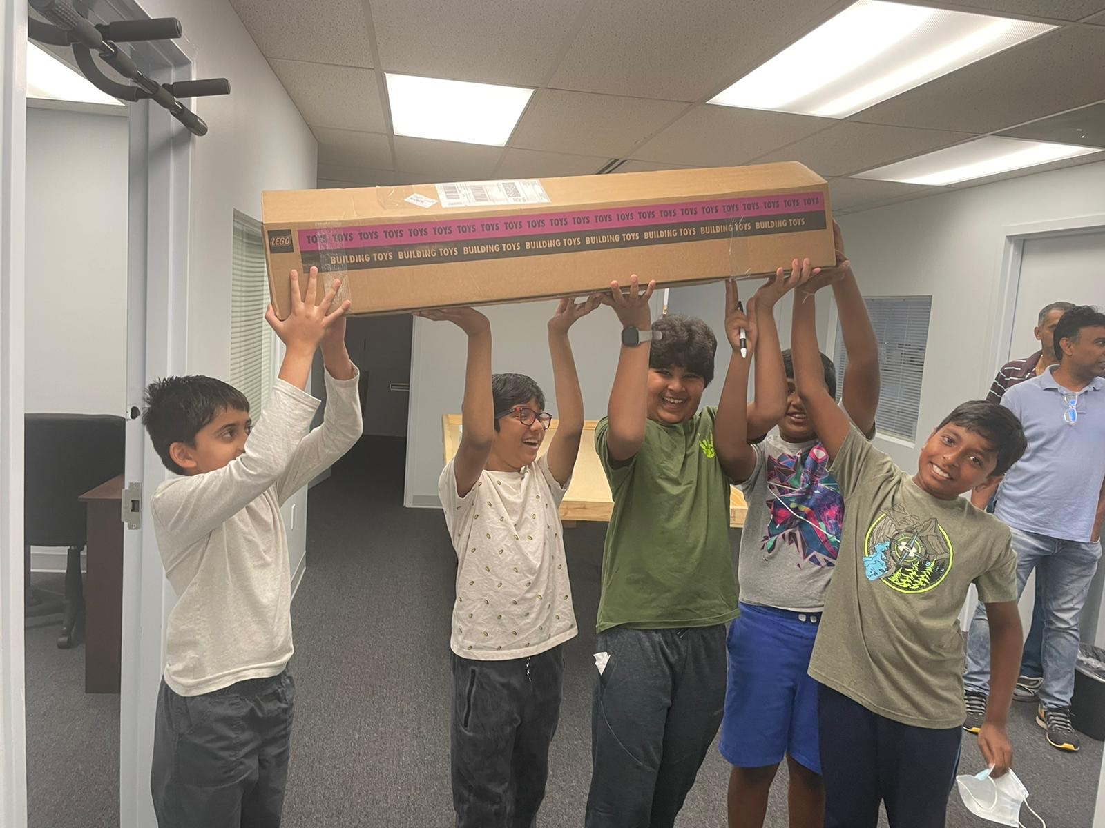
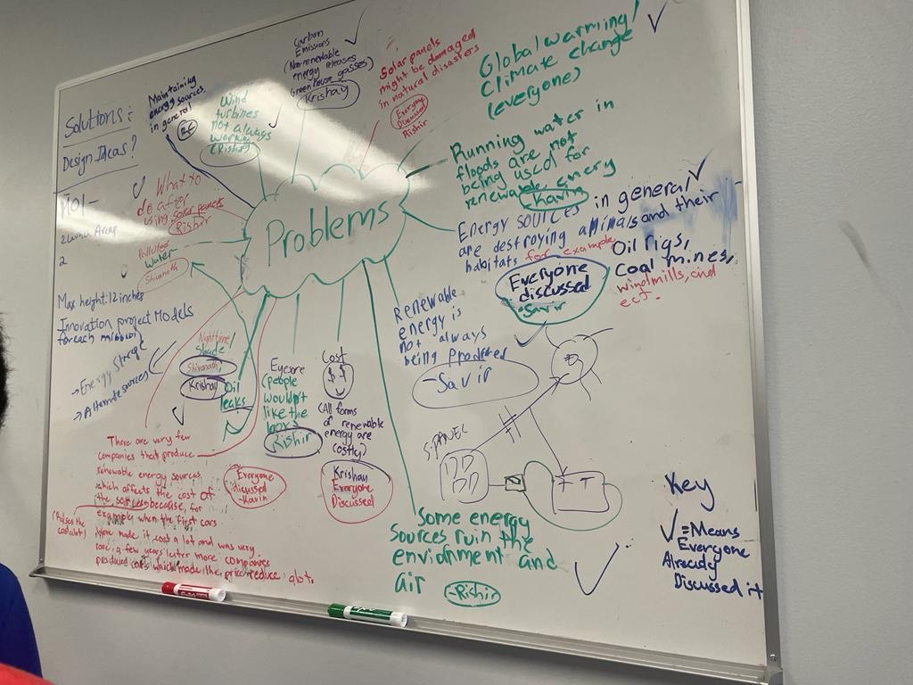
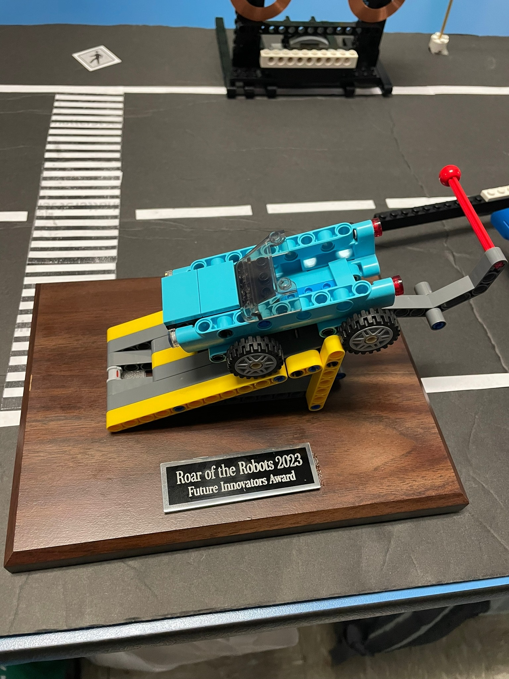
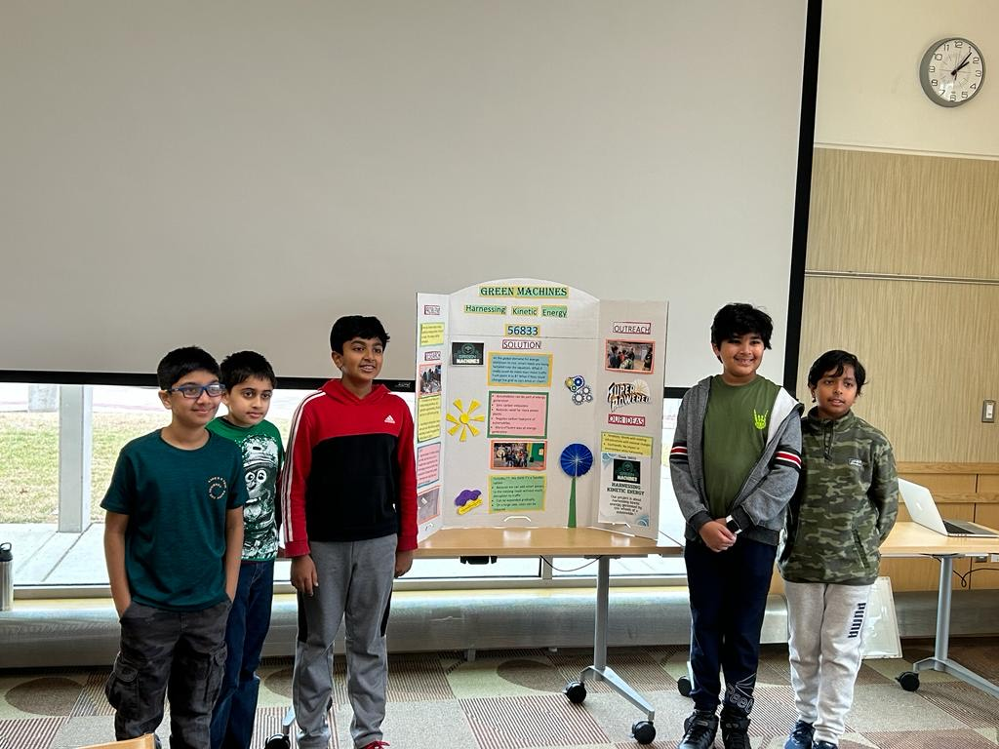
Project and Robot Coding Timeline
September-October
November
December
January
Weekly
Week 1:
1. Team kickoff
2. Coaches introduced First Lego Superpowered to the team
Week 2:
1. Setup, Planning, and Requirements.
2. We worked on the Legos to build the structure of each mission and placed them on the map.
November (Weekly)
Week 1: Created a project schedule and the team researched on identifying the problems for the innovation project
Week 2: Discussed problems, and solutions and researched data. Learned basics of robot design coding.
Week 3: Gathered more ideas on robot design and finalized the project based on problem discussions for the Innovation project.
Week 4: Extensively started building attachments and coding. Completed 5 to 6 missions and started building the innovation project.
December (Weekly 2 to 3 times):
Week 1: Completed the Innovation Project Model and wrapped up the attachments, robot design, and coding.
Week 2: Prepared project presentation and practiced more.
Week 3: Reached out to NASA Goddard and presented our project presentation at our local library to a larger audience. Baselined the code in GitHub, performed test runs, and improvised code.
Week 4: Did more outreach to experts in the field.
January (Weekly 2-3 times)
Week 1: Found more patterns in our project. We also worked on an Innovative Project Model to capture the Cymatic Patterns and worked on improving the code precision.
Week 2: Outreached to Dr. Mitra (Psychiatrist) on Cymatics in therapy to relieve anxiety and stress. We also presented our project at the local library to a larger audience
Week 3: Frozen the code changes and worked on final presentations, code precisions, and dry runs to prepare for the Qualifiers
Week 3
Week 4
Worked on the missions to increase the score probability with multiple dry runs.
1. Brainstorm ideas for attachments and efficient ways to complete missions
1. Tested out code after creating code for basic missions

Slide 5
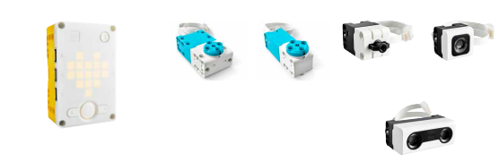
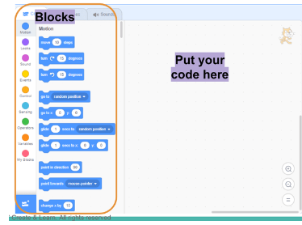
Code and parts that we used
Block Code Programming
Keywords: Blocks, loop blocks, motion blocks, event blocks, yaw angles, sounds, sensors, operators, project and variables.
Robot parts
Controller/Brick: Bluetooth, Power Button, etc.
Sensors: Color, Gyro
Motors: Big motor, Small motor
Wheels: Small, Big
Motors
Brick
Sensors

Slide 6
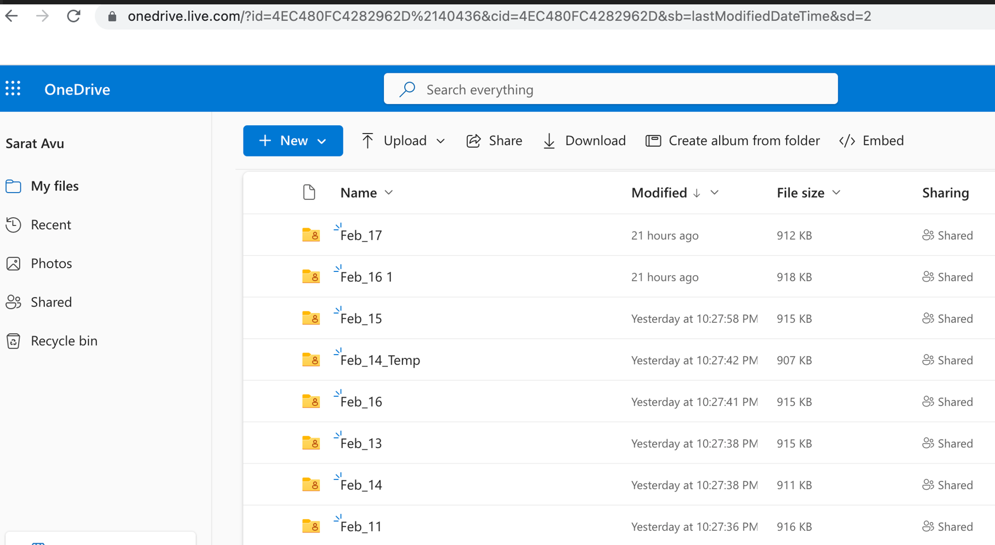
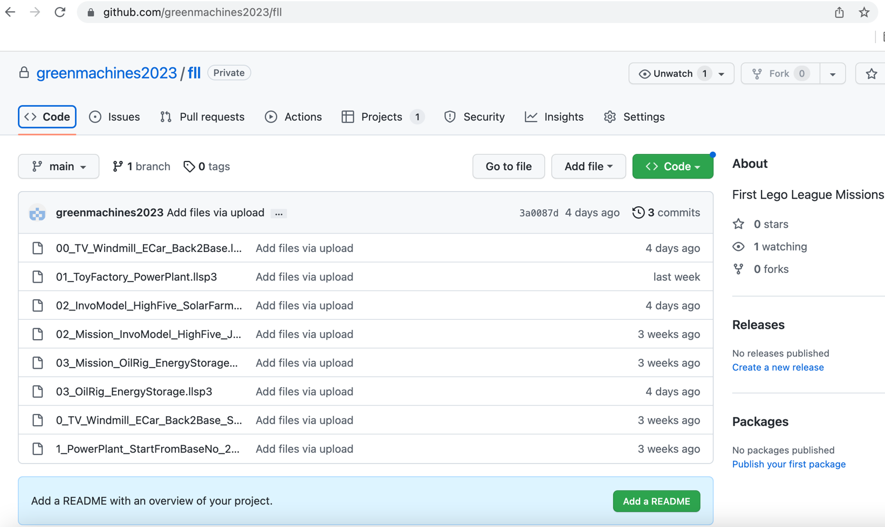
Code Storage and Versioning: OneDrive , GitHUB
OneDrive
Initially we stored the code every session weekly on the cloud/OneDrive so that everyone has access to it.
Later we migrated to maintain the code in Github which helped us with version controlling to be able to return to the prior code versions in case of any failures.
Github

Slide 7
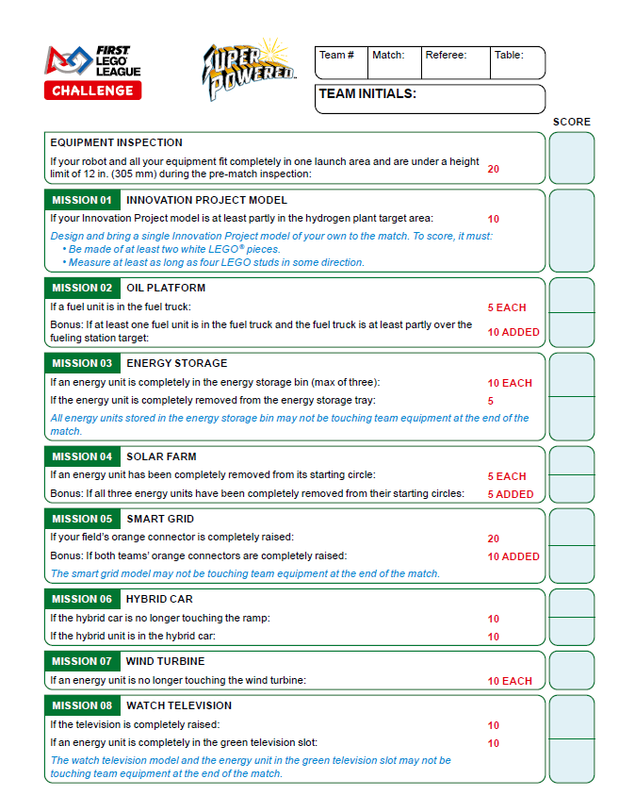
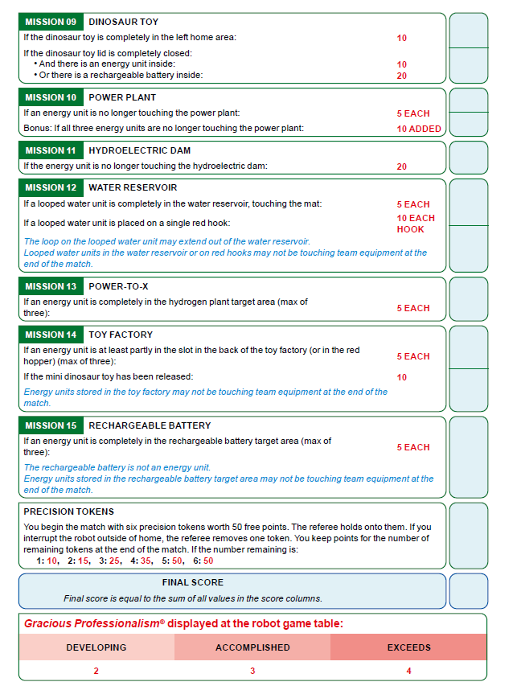

Slide 8
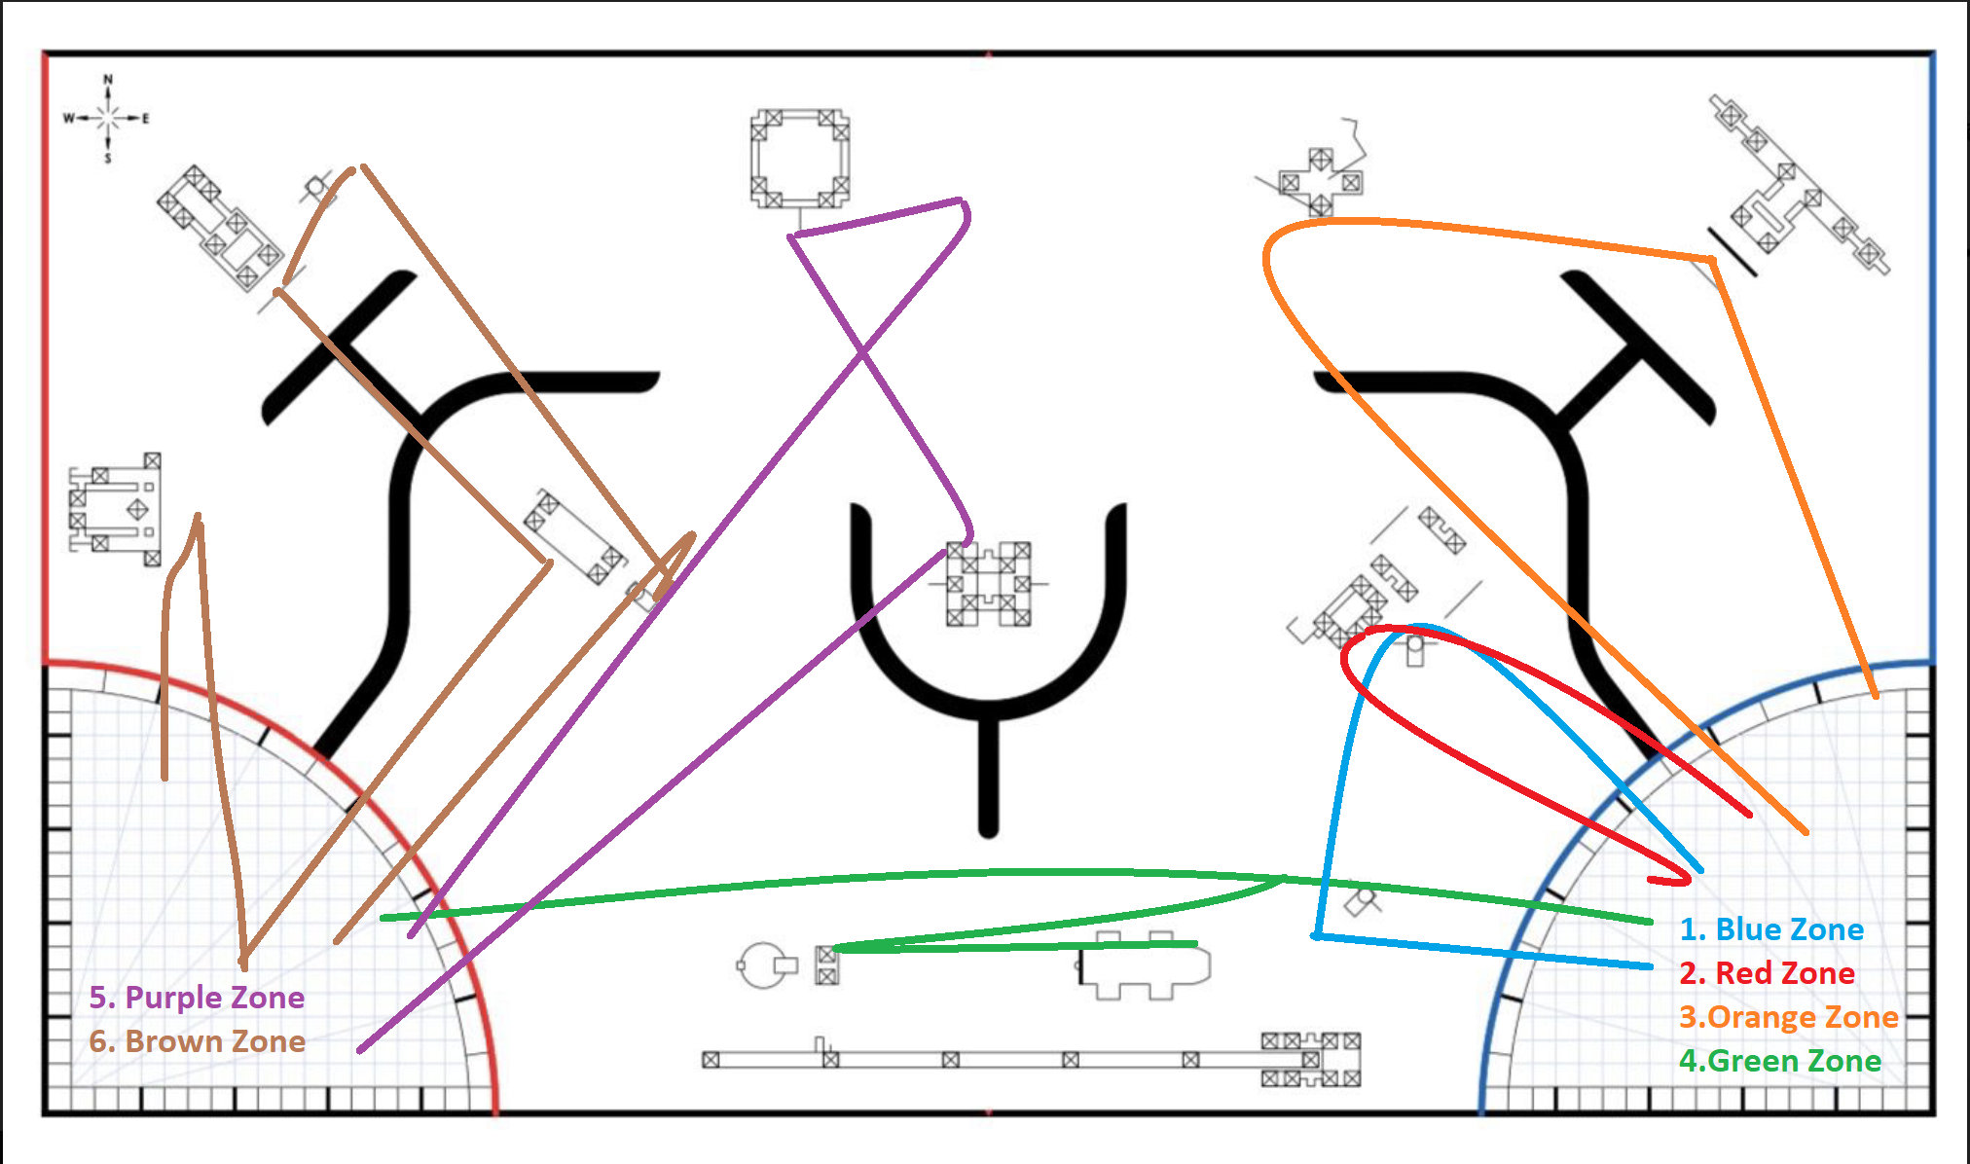
Map with Run Zones

Slide 9
Mission strategy
We distributed the missions (2 to 3 for every zone) so that the robot can cover as many missions as possible with each attachments, but also fit in the time constraint.
Zone 1
1
Watch TV - 20
Max Points: 70
Zone 2
2
Toy Factory--25
Build Dinosaur-30
Zone 3
3
Innovation Model-10
Zone 4
4
Oil Platform-25
Wind Turbine - 30
Hybrid car - 20
Grab Rechargeable Battery for the Dinosaur
Power Plant-25
Hydroelectric Dam-20
Smart Grid-20+10
Water Reservoir-15
Solar Farm-20
Energy Storage-35
Power to X: 15
Zone 5
5
Max Points: 100
Max Points:75
Max Points: 75
Zone 6
6

Slide 10
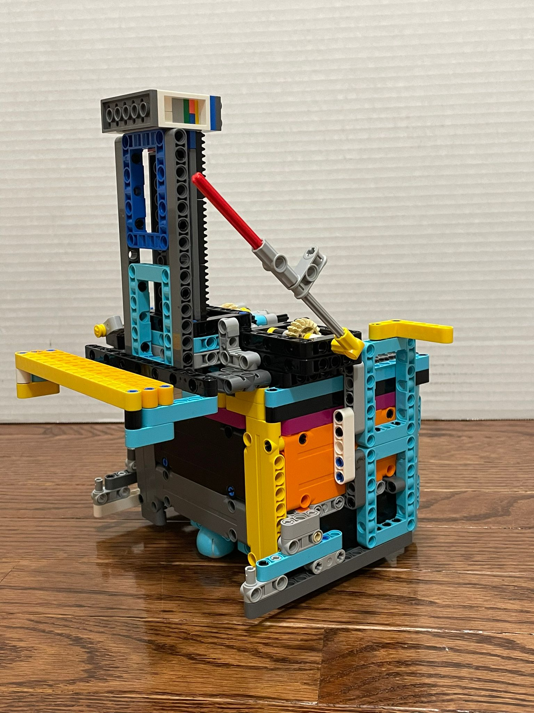
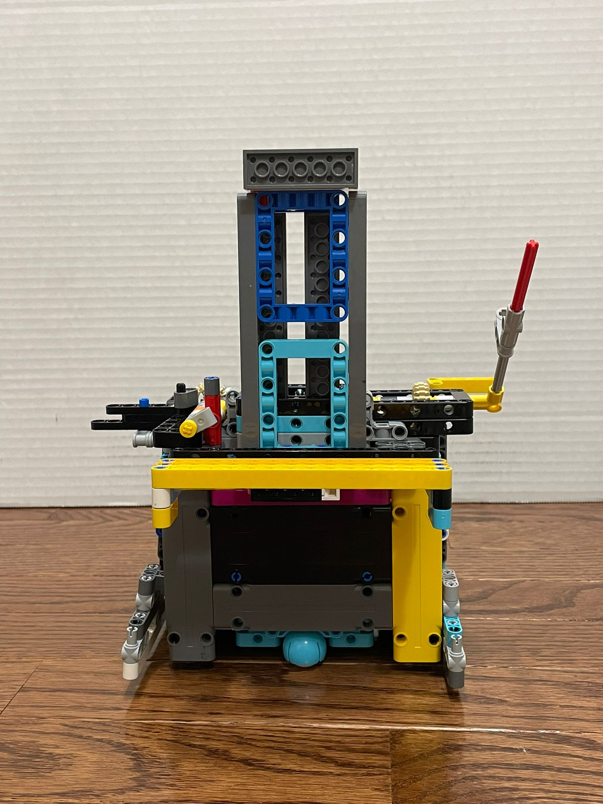
Robot Design
Robot Side View
Robot Front View
Innovation Model
Our robot is built with 2 color sensors, 1 gyro sensor and 4 motors (2 big and 2 small) and have the forklift and the EU Dropper connected to the base station. We have three more attachments clawper, scooper and box that help us solve all the missions we planned to accomplish

Slide 11
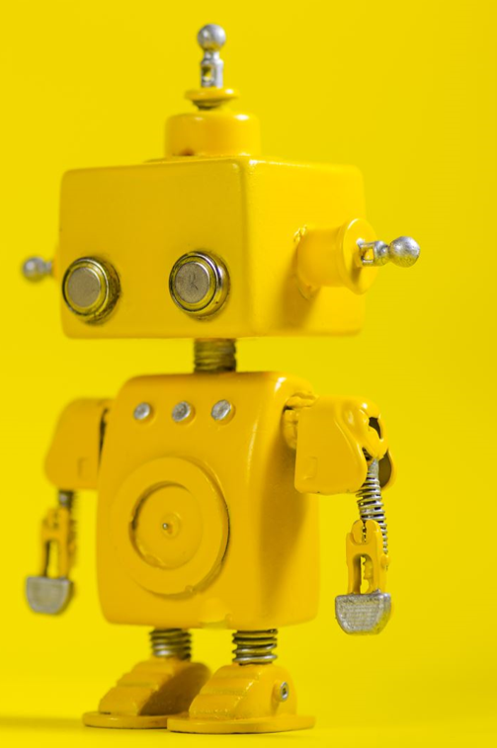
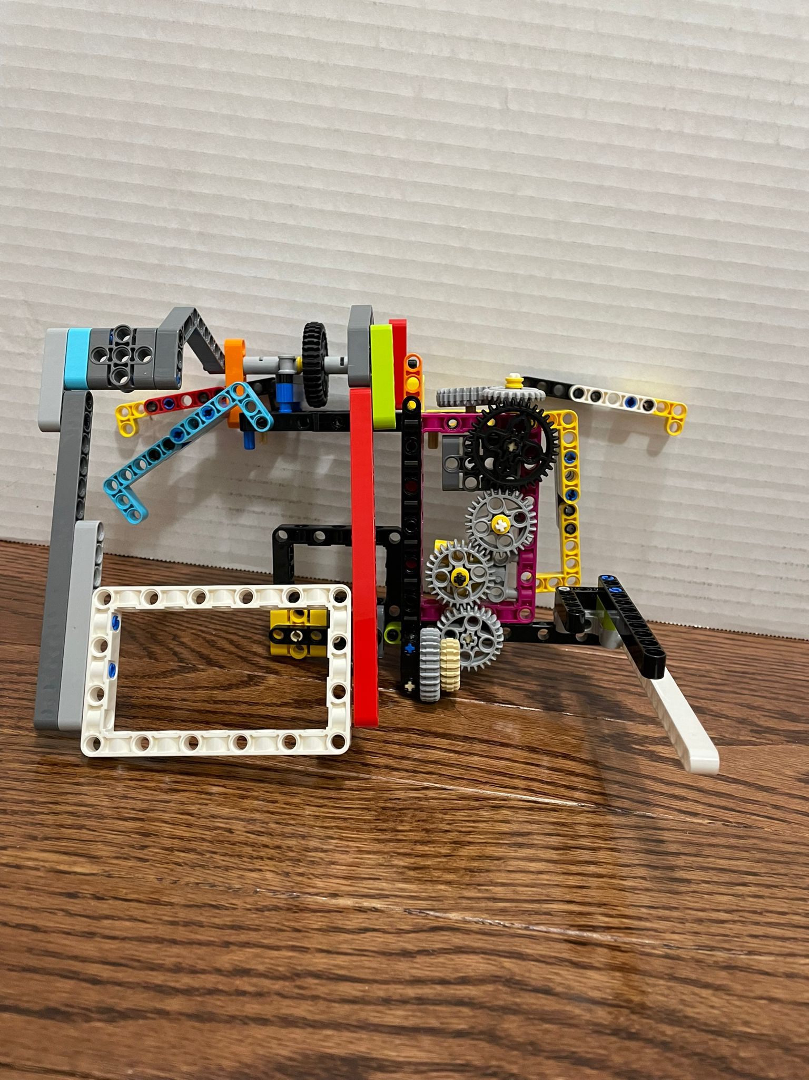
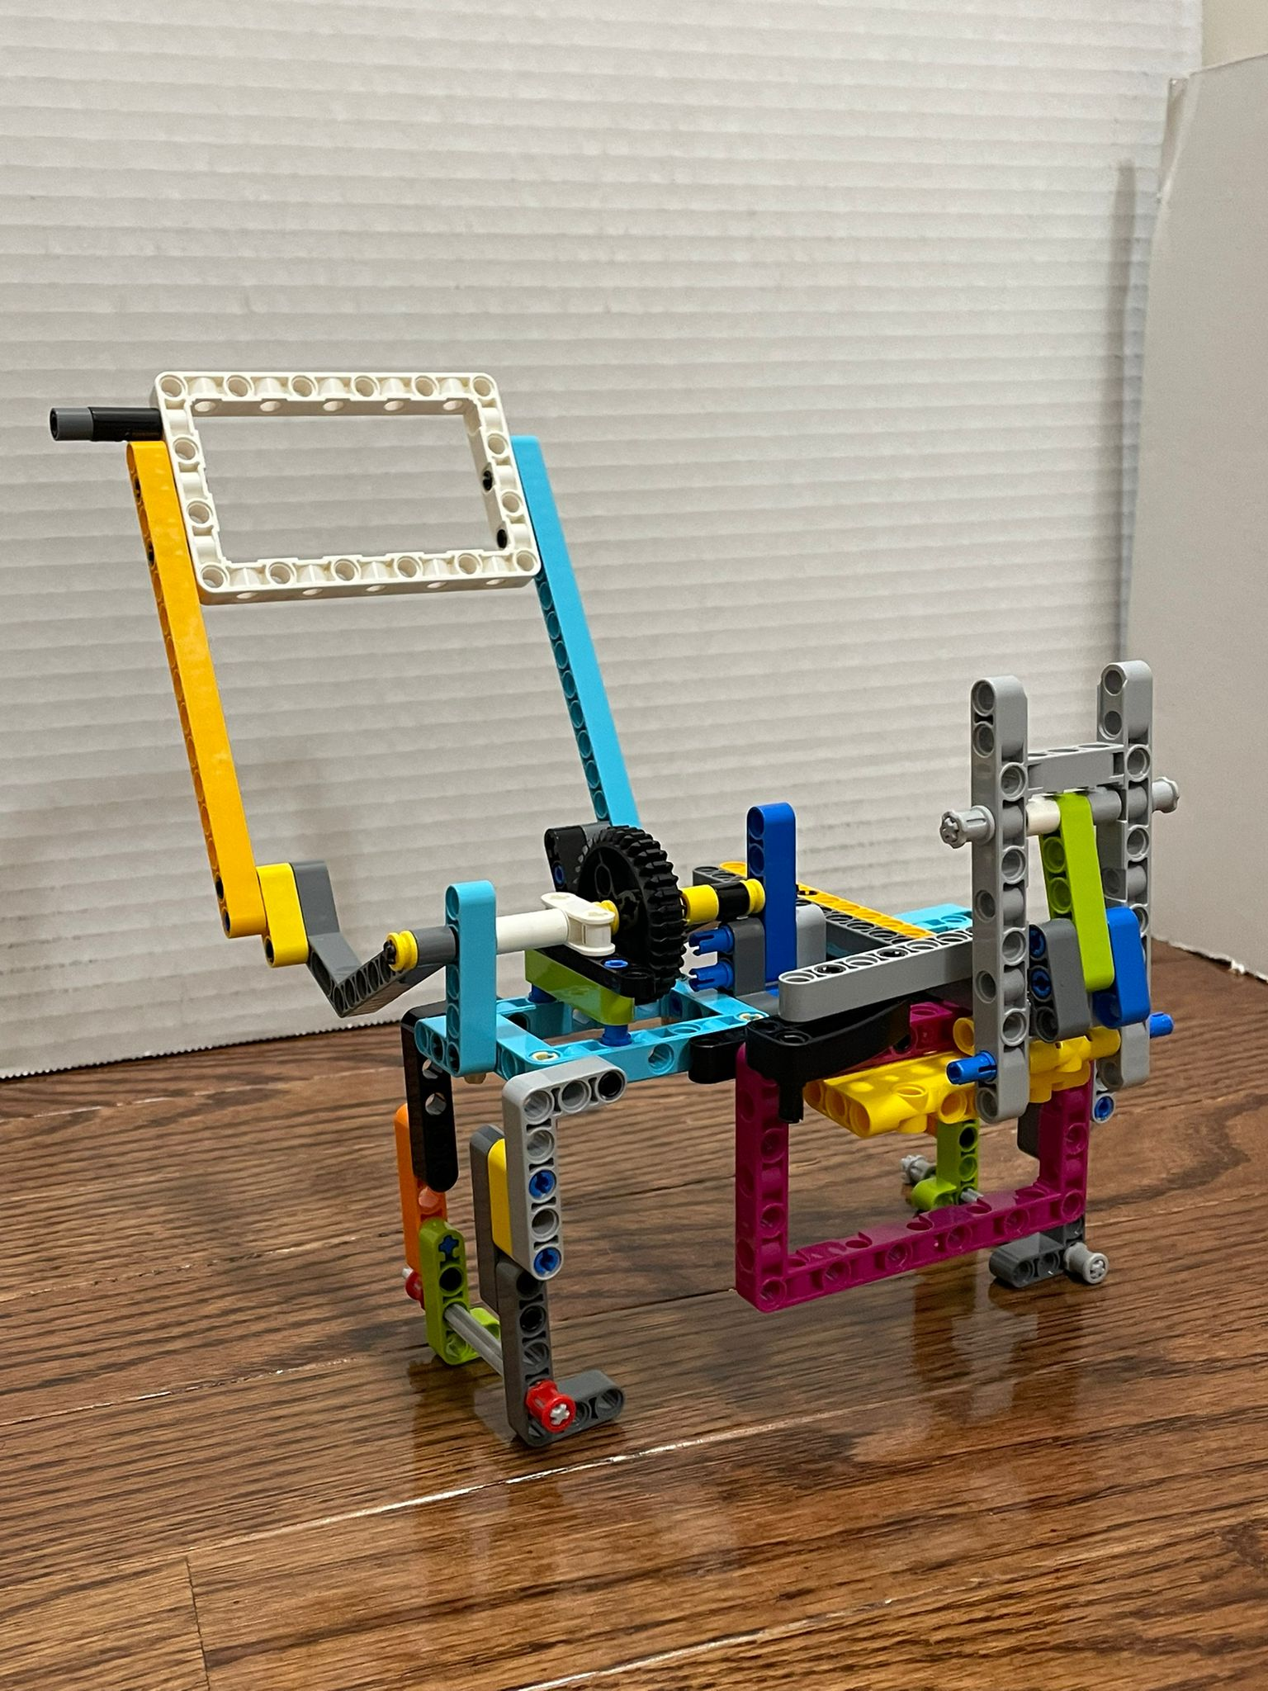
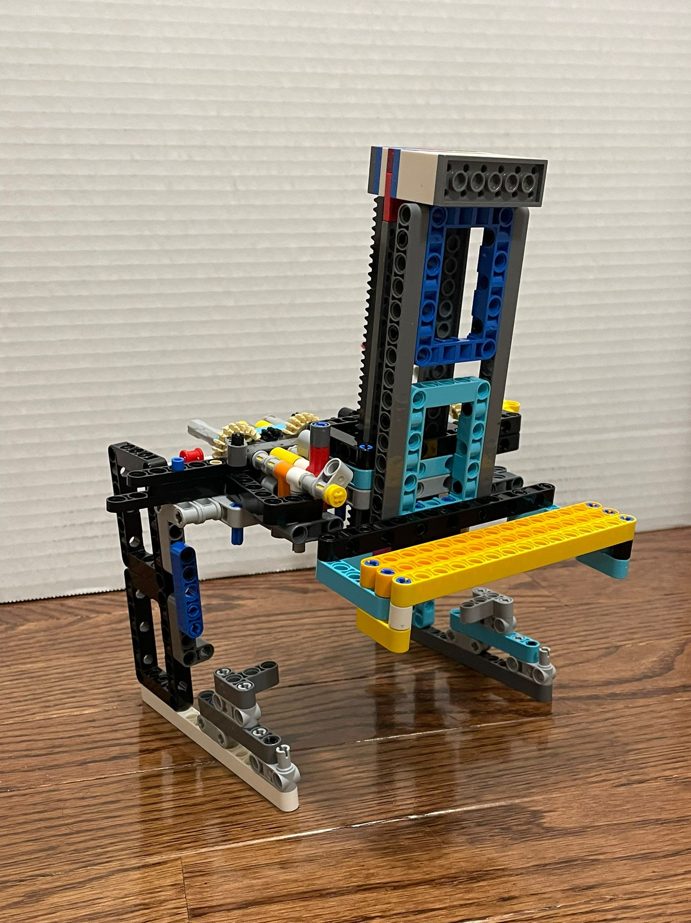
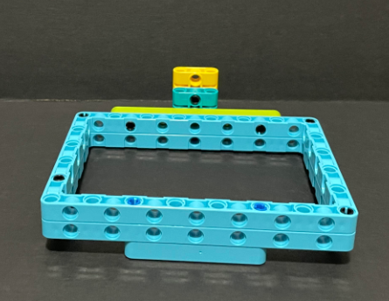
Robot Attachments
Gear Monster
Box
EU-Dropper
Lift?

Slide 12
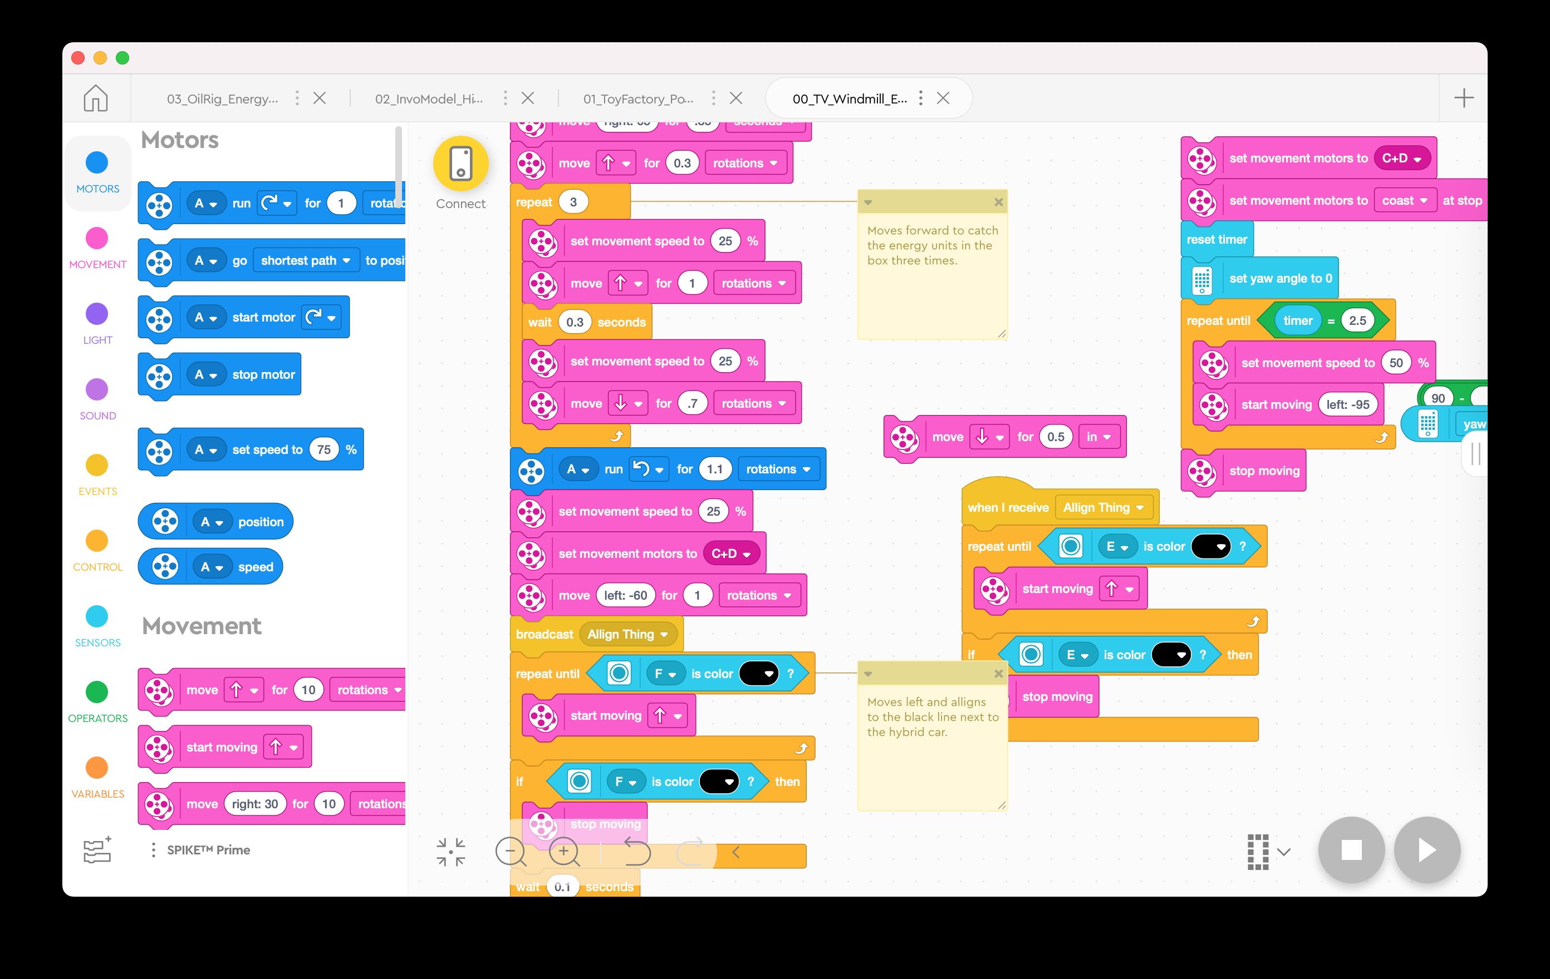
Run 1 Code
We start at the blue base. We have the dropper attachment still on and so is the forklift, we also have a large blue box connected to the front of the robot. Therefore we have to go just a little bit forward from the base to push the tv. After we do that we take a left then take a right and push the blue box into the windmill mission three times. Ultimately, the box collects some energy units and with them still inside, we take a left, go forward, then take a right. Using the forklift we lift up the hybrid car and the box still has the energy units in it. From there we take a small left and move backwards back to base, so it catches the rechargeable battery when it comes back.

Slide 13
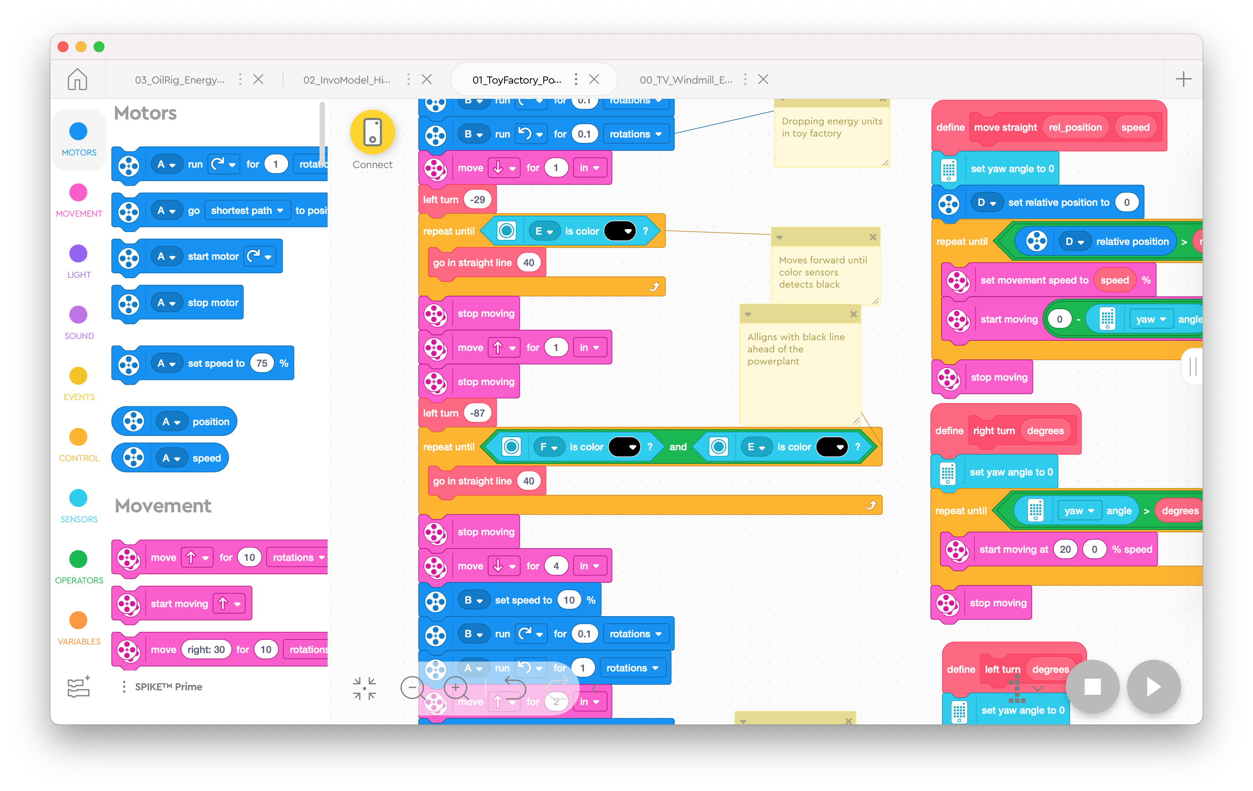
Run 2 Code
For the setup of run #2 we still have the dropper attachment and so is the forklift. We setup the robot in front the toy factory and put the rechargeable battery inside the dinosaur. We also replace the box with a claw. We load up the energy units in the dropper then send it off. When the robot gets to the toy factory, it drops the energy units in the toy factory then takes a left and aligns to the black line. From there it takes a left so that it is directly in front of the powerplant. The dropper moves down which releases the black Lego piece which allows the forklift to go down and be aligned to the space between the mission. It then lifts the power plant up and the dropper goes back which allows the forklift to go down. When doing this, the energy unit that releases from the power plant catches in the claw. After that, it goes back and takes a right. It goes forward and then the dropper lifts the hydraulic dam mission. From there it goes back, takes a left, goes forward, then takes a right to be right in front of the water unit and energy unit that just released. It catches the water unit by going forward then taking a left and going to the red base.

Slide 14
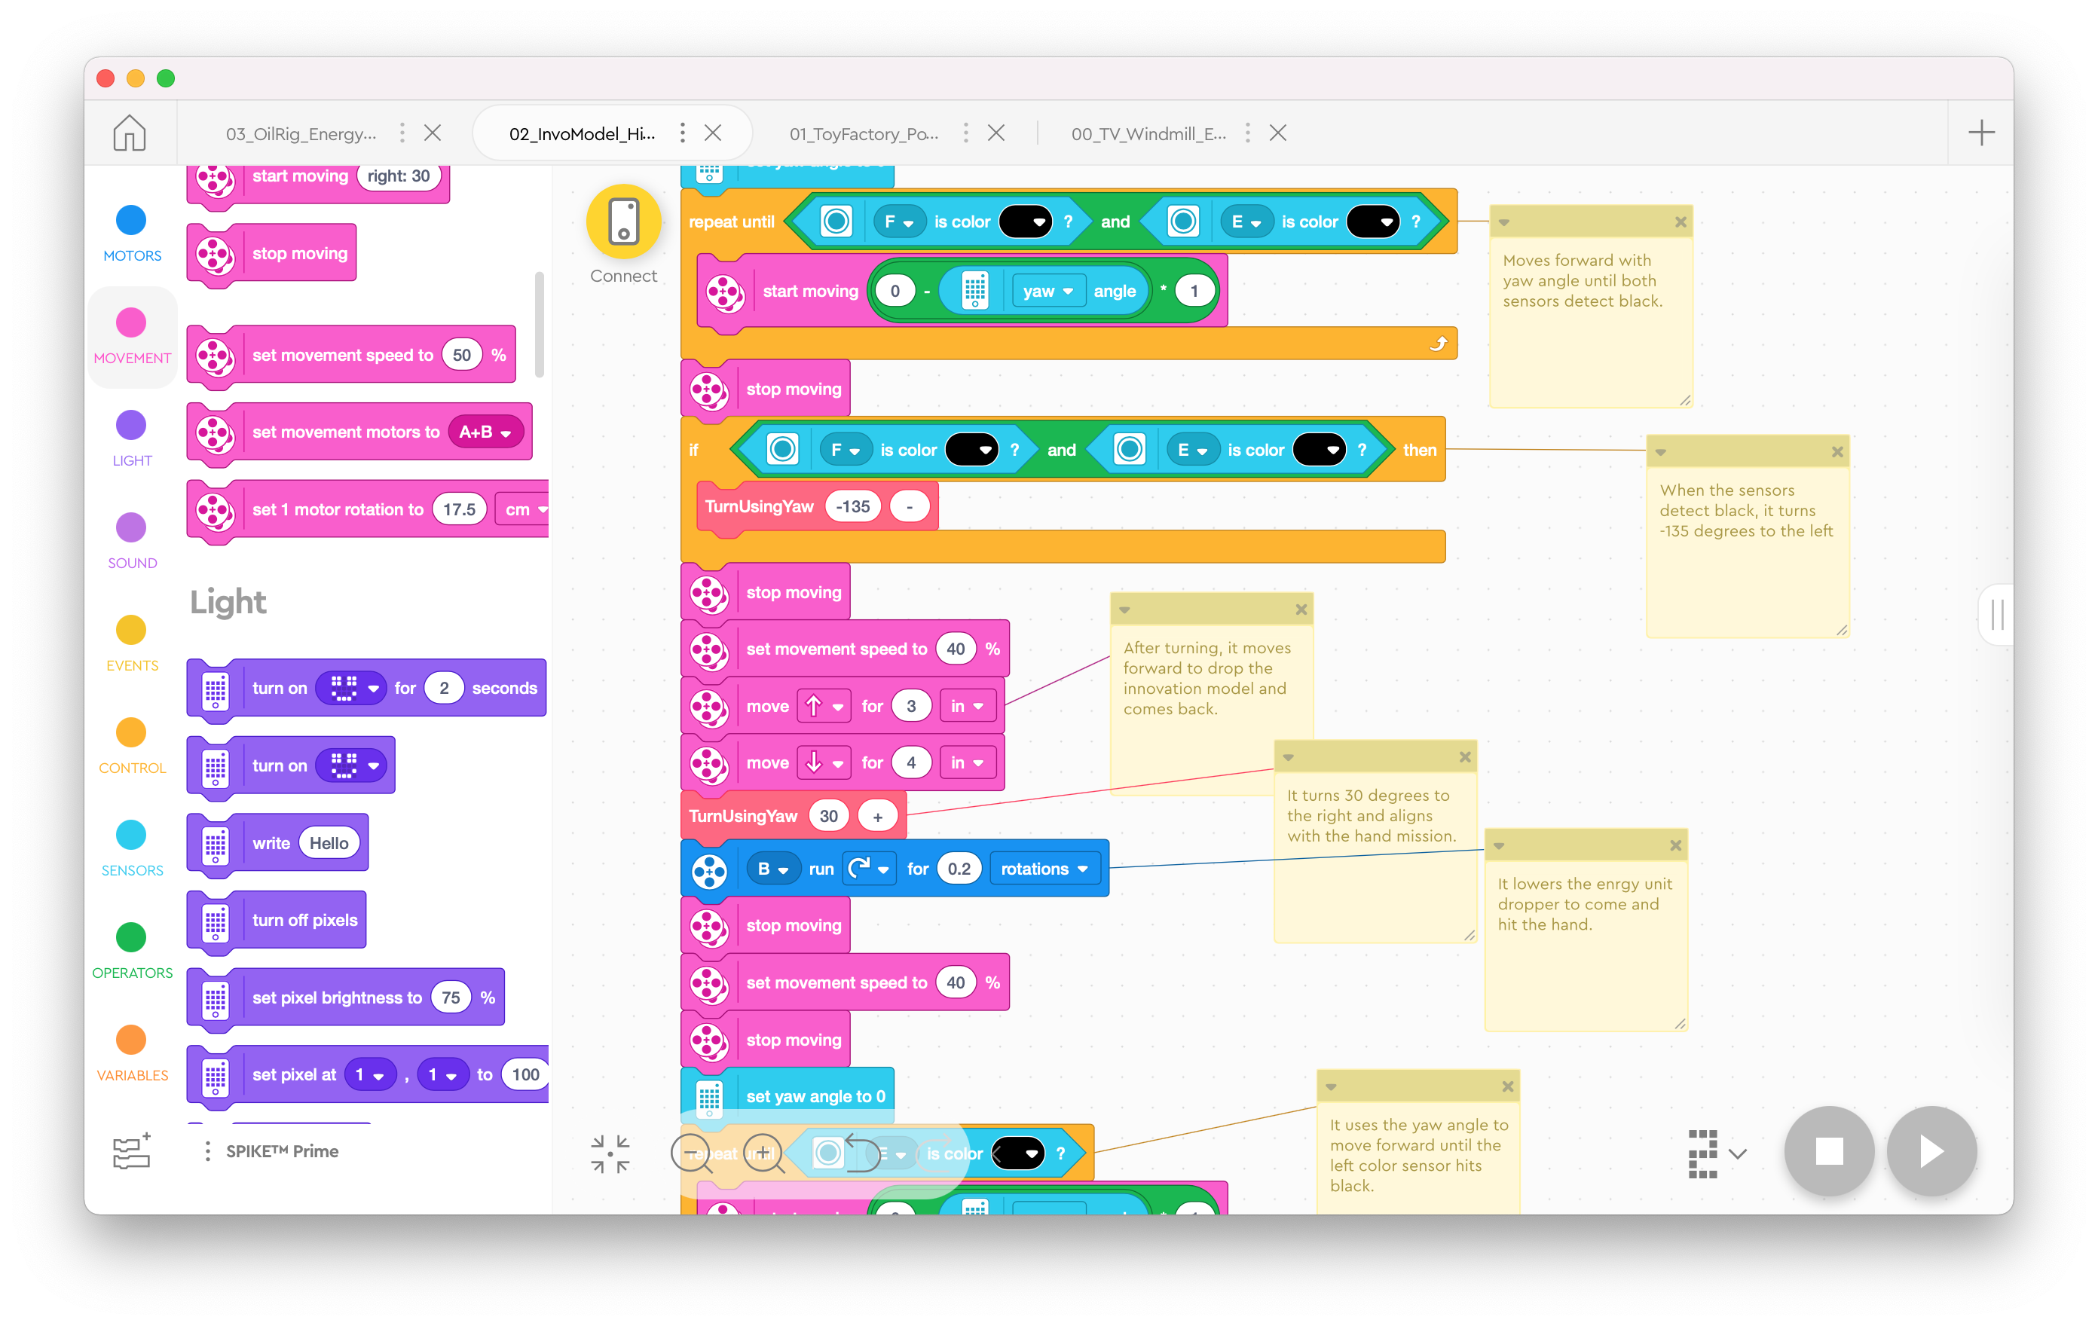
Run 3 Code
Once the robot returns to the red base after run #2, we turn the robot so that it is facing the black line in front of the power plant mission. We insert the innovation model in the scooper, standing up right then send the robot off. It moves forward until it hits the black line, then takes a large left, goes forward, and comes back, releasing the innovation model. After it comes back, we take a right and go forward all the way until the smart grid. Since the dropper is on the right side, we go at a slight angle so that it can go forward and push the smart grid up. From there, we go backward a little, take a left and grab the two Water Reservoir units and take a large turn to catch the energy units from the solar farm. After this, it takes a left and goes back to base.

Slide 15
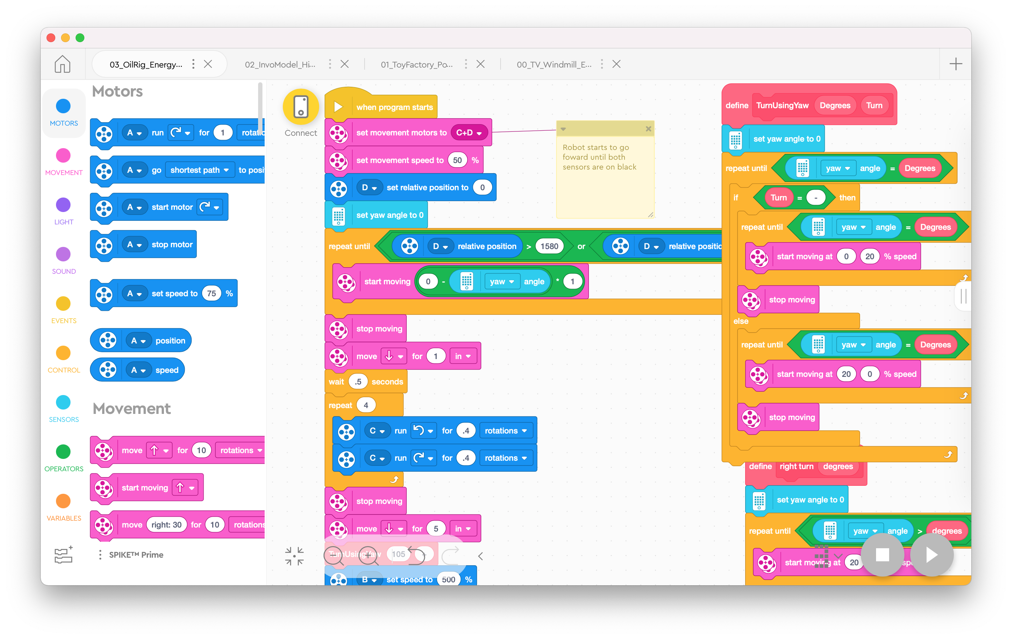
Run 4 Code
We take off the claw and replace it with a combined attachment Clawper. This attachment has a one-way door like attachment and a lowered passive dropper attachment. We also take the water reservoir units that we collect and put it on the dropper. Then we put any extra energy units on the robot. From the base, we set it up, so it just has to go forward and using the oil rig attachment (a small ramp like attachment) which is on the left of the attachment to lift the oil rig three times by going back and forth. Already from there, the dropper attachment gets pushed by the energy storage and the energy units in the dropper gets dropped into the energy storage. As well as those missions happening, the one-way door like attachment hooks on to the energy tray and pulls it. After that, the robot moves back, takes a right and dropped the water reservoir units into the circle. After that it takes a left, moves forward and takes a right and park in the power to x mission. With all the energy units including the ones on the robot, we will get the power to x mission.

Slide 16
Run 5 Code
We take off the claw and replace it with a combined attachment Clawper. This attachment has a one-way door like attachment and a lowered passive dropper attachment. We also take the water reservoir units that we collect and put it on the dropper. Then we put any extra energy units on the robot. From the base, we set it up, so it just has to go forward and using the oil rig attachment (a small ramp like attachment) which is on the left of the attachment to lift the oil rig three times by going back and forth. Already from there, the dropper attachment gets pushed by the energy storage and the energy units in the dropper gets dropped into the energy storage. As well as those missions happening, the one-way door like attachment hooks on to the energy tray and pulls it. After that, the robot moves back, takes a right and dropped the water reservoir units into the circle. After that it takes a left, moves forward and takes a right and park in the power to x mission. With all the energy units including the ones on the robot, we will get the power to x mission.

Slide 17
Run 6 Code
We take off the claw and replace it with a combined attachment Clawper. This attachment has a one-way door like attachment and a lowered passive dropper attachment. We also take the water reservoir units that we collect and put it on the dropper. Then we put any extra energy units on the robot. From the base, we set it up, so it just has to go forward and using the oil rig attachment (a small ramp like attachment) which is on the left of the attachment to lift the oil rig three times by going back and forth. Already from there, the dropper attachment gets pushed by the energy storage and the energy units in the dropper gets dropped into the energy storage. As well as those missions happening, the one-way door like attachment hooks on to the energy tray and pulls it. After that, the robot moves back, takes a right and dropped the water reservoir units into the circle. After that it takes a left, moves forward and takes a right and park in the power to x mission. With all the energy units including the ones on the robot, we will get the power to x mission.

